Slide 1

Eye Guide
Supervised by:
Dr: Salsabil Amin
TA: Mona Sadik

Slide 2
David Maged
Joseph Ezzat
Ibrahim Sayed
Haya Hesham
Marlyien Magdy
Team Members

Slide 3

Problem Definition

Slide 4

Problem Definition
According to the world blind union, there are about 253 million people around the world with serious vision problems.
There are about 47 million of them who are blind.
Visually impaired people can sense light and shadows only and cannot see objects in front of them.

Slide 5
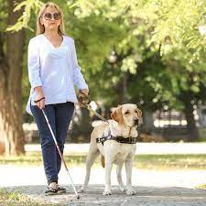
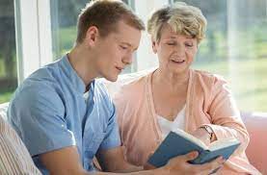

Problem Definition
Visual impaired and blind people frequently do not detect or recognize outdoor obstacles.
They need guidance to avoid risks.
Eye Guide will help the visually impaired and the blind people in an outdoor environment without depending on other people.

Slide 6

Motivation

Slide 7
Help them enjoy their life.
Help them to be more independent.
Help them navigate outdoors safely.
Relieving them from feeling that they are burdens on other people or family members all the time.
Motivation

Slide 8
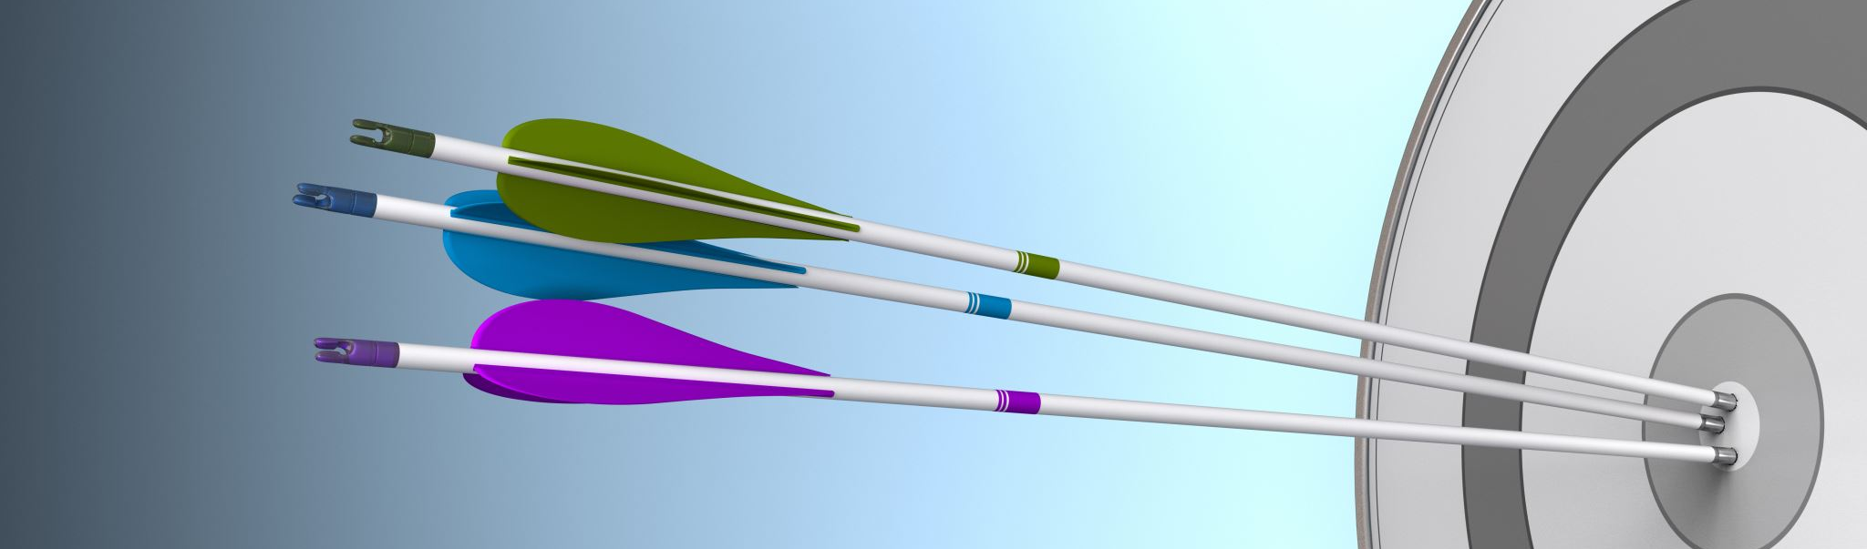
Objective

Slide 9
Build an Android application with these features.
Face recognition feature to help them recognize familiar people.
Currency recognition feature to be able pay at any market.
Speech recognition feature to help communicating with them
Guidance feature to help them navigate outdoors safely.
Objective
WE added OCR Feature.
Predict the distance in feet between them and obstacles to help them avoid colliding with it.
Guide them to their destination by calculating a safe path in feet with directions.
Detect and recognize obstacles at outdoors environments.
Such as: Cars, Trees, Stairs, motorbikes, Traffic Lights, etc

Slide 10

System Architecture

Slide 11
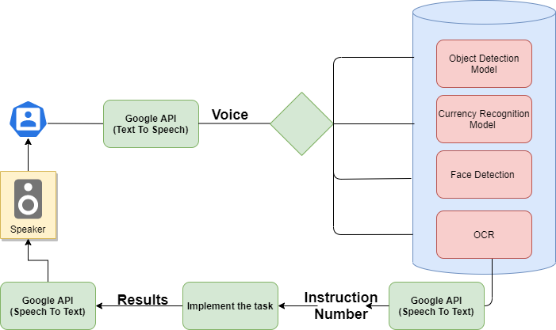
System Architecture

Slide 12
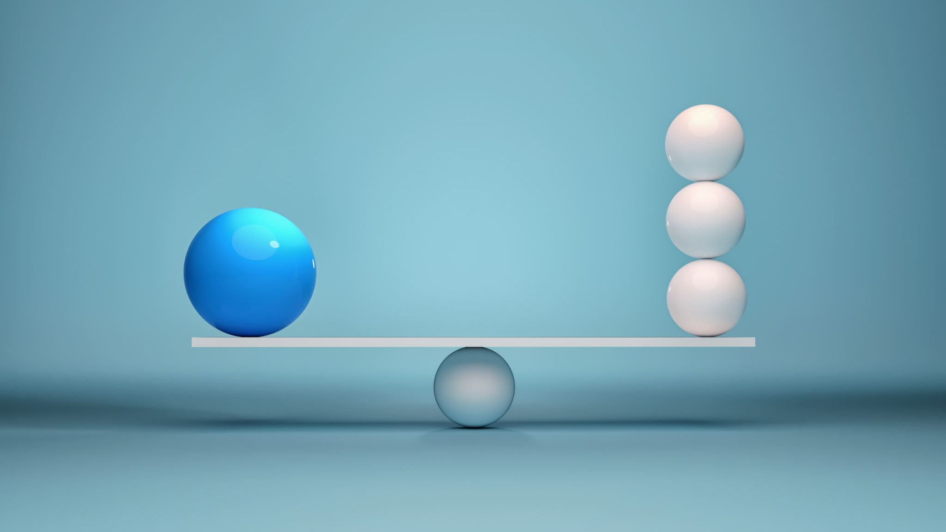
Phases
Description

Slide 13
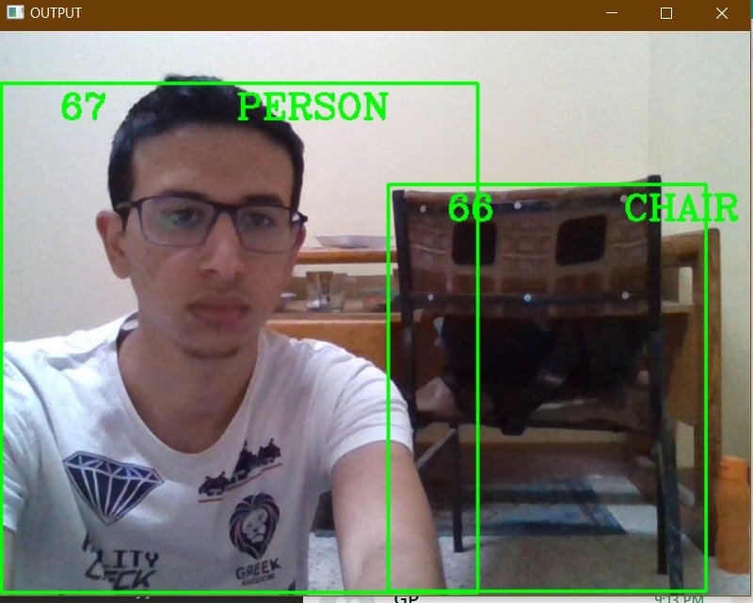
1. Object Detection & Recognition
Trained on COCO Dataset using YOLO V4
Can classify 91 Objects With an accuracy of 95%

Slide 14
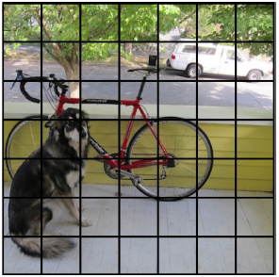
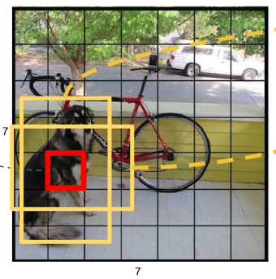
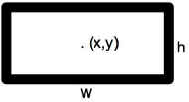
How YOLO works?
Divide the image into the S*S grid.
2. Each grid cell predicts B boxes(Each grid cell predicts B boxes(x,y,w,h) and confidence of each
box P(Object).
Bounding box parameters:

Slide 15
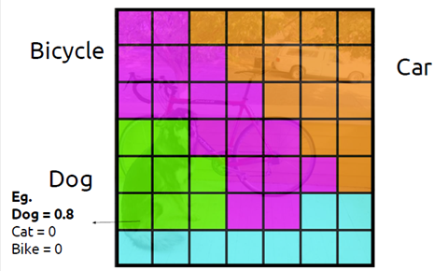
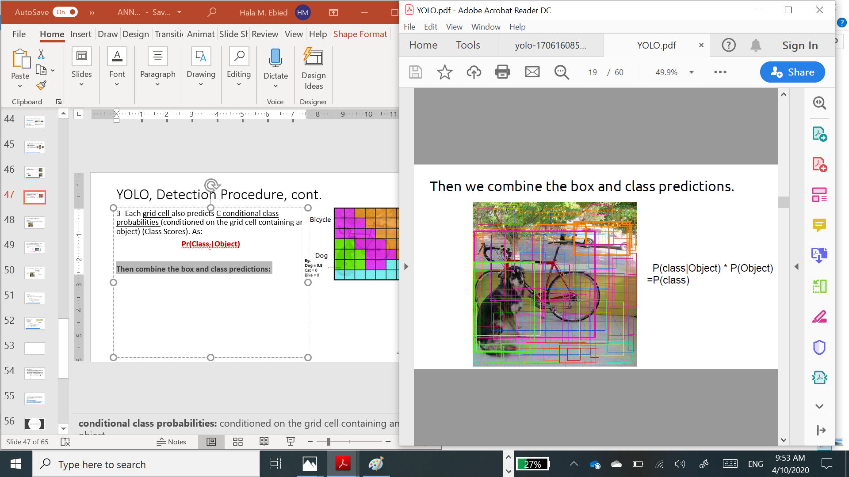
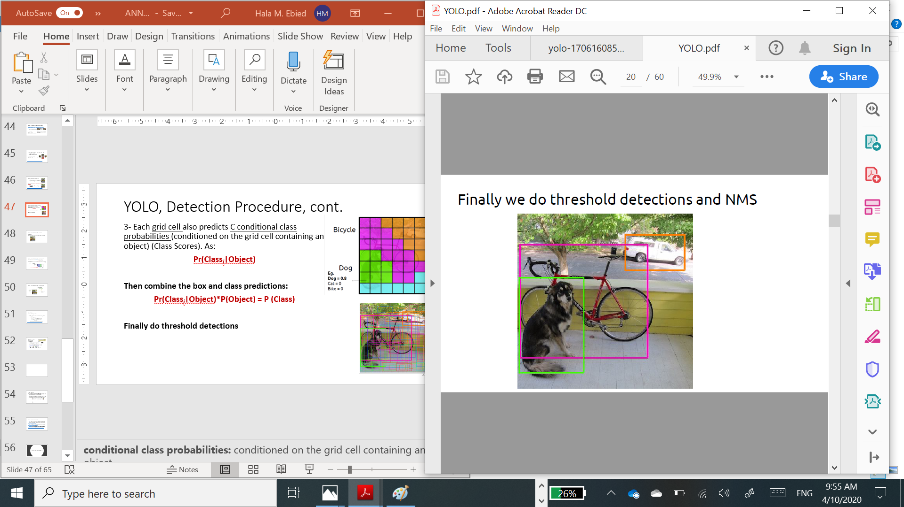
How YOLO works? (Cont.)
3. Each grid cell also predicts C conditional class probabilities (conditioned on the grid cell containing an object) (Class Scores).
As: Pr(Classi|Object)
4.Then combine the box and class predictions:
Pr(Classi|Object)*P(Object) = P (Class)
Finally, do
threshold detections and
Non-Maximum Suppression (NMS)

Slide 16
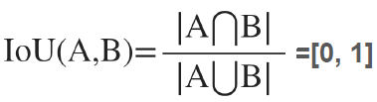
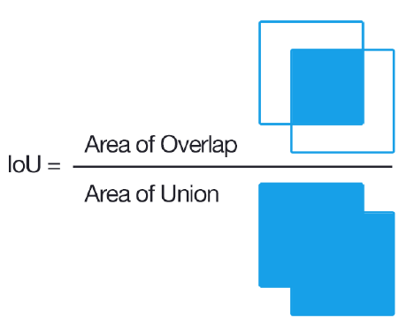
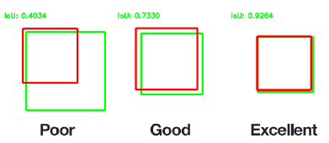
Non-maximum Suppression (NMS)
Compare “bbox_max” with others less score (non-zero!) bboxes. Let’s denote it “bbox_cur”.
If IoU (bbox_max, bbox_cur)> 0.5 then set 0 score to bbox_cur.
Intersection over Union (IoU)

Slide 17
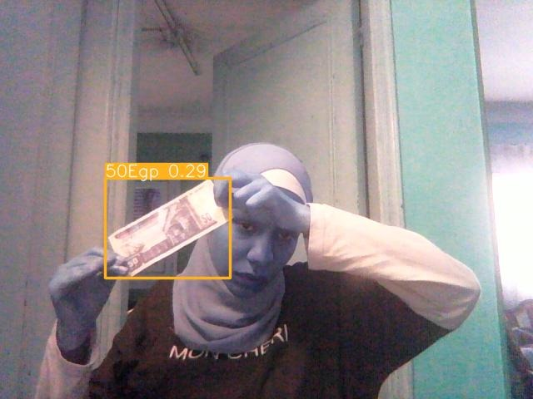
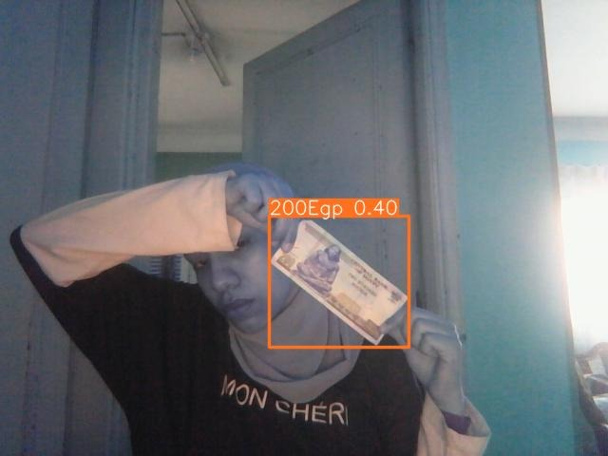
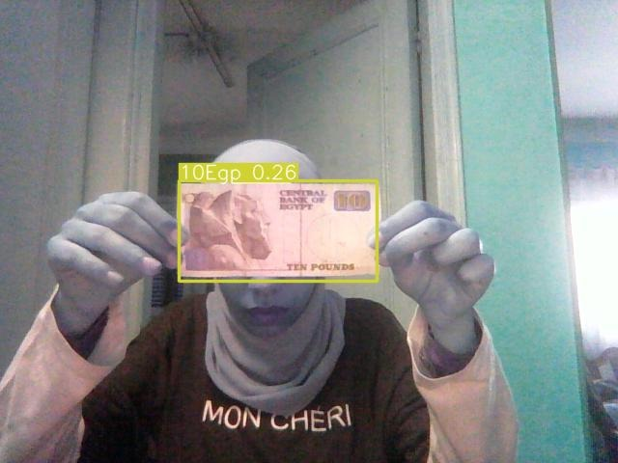
Worked on Egyptian Currency Dataset Published by Kaggle.
Done using YOLO V4.
Accuracy 87%
Precision (+75%)
Recall (+96%)
2. Currency Recognition

Slide 18
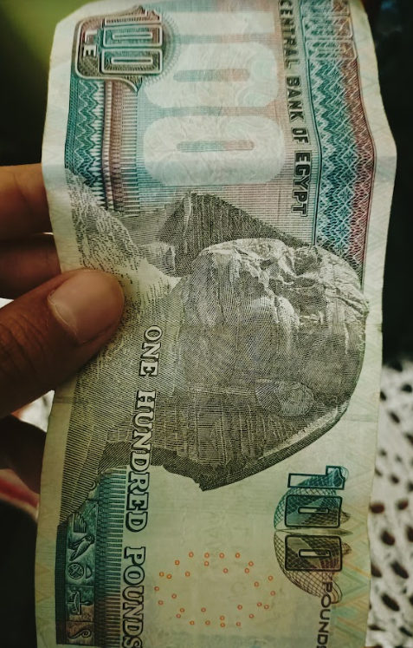
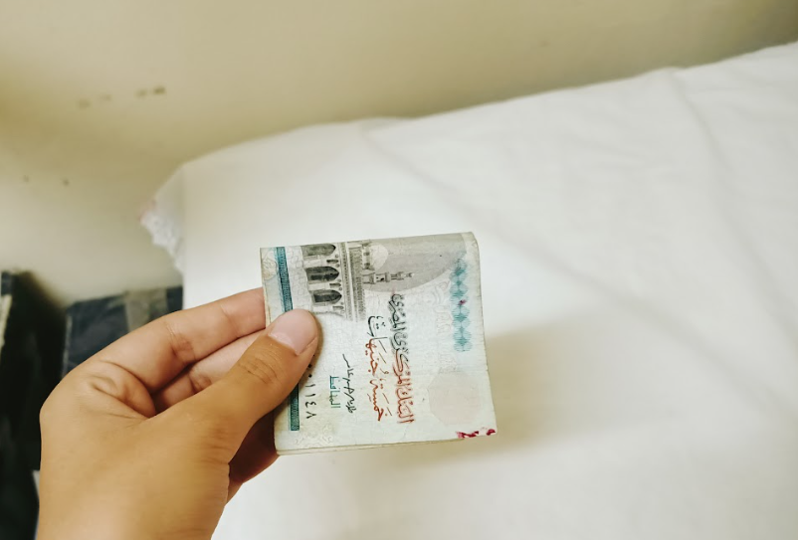
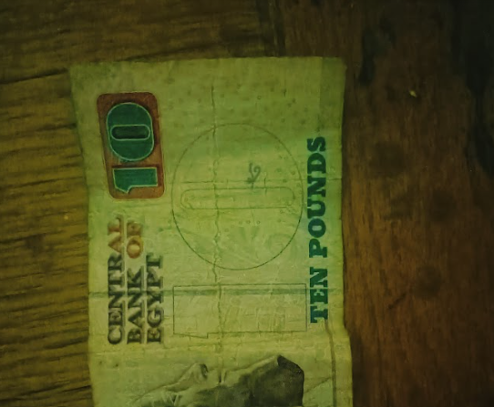
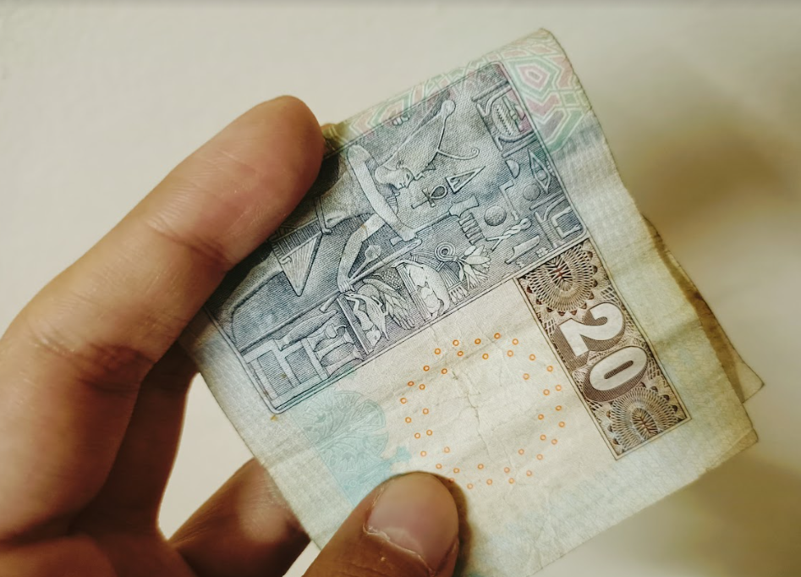
Challenges
All images have the same shooting mode, light mode, and position.
Solved, by adding +200 images for each class.
Examples of added photos.

Slide 19
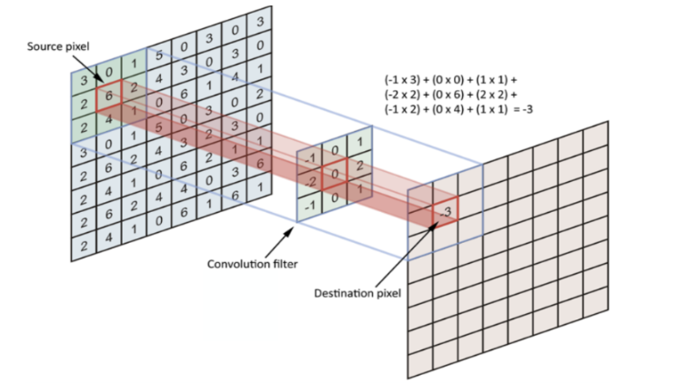
How this feature is implemented?
We used YOLO V4 and Convolution Neural-Network using collab’s GPU.
Why CNN?
High accuracy.
sparse connections reduce overfitting.
Feature extraction done automatically.

Slide 20
Steps:
Extracting features by “Filters”.
The filters find the best features using the backpropagation algorithm.
Connecting it to an output layer.
We used mini-batch gradient descent with a batch of 16 samples,
Resized the images to be 416x416
Started the training process for 40 epochs
How this feature is implemented? (Cont.)

Slide 21
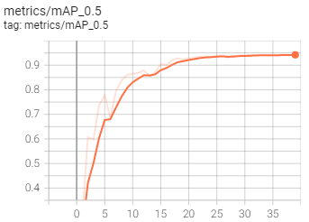
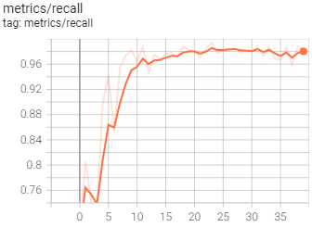
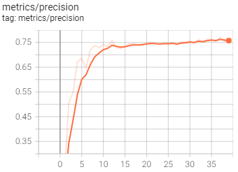
Currency Recognition Model Results.
Precision (TP)
Mean average Precision: 0.5
Recall

Slide 22
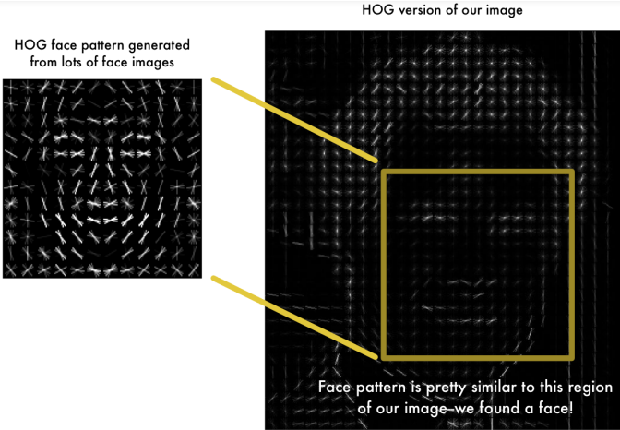
3. Face Detection implementation
We have implemented this feature using modern techniques including CMake, dlib, and face_recognition python libraries.
Finding all faces using the HOG algorithm.
Image is turned into black & white
Replacing pixels with gradients.
Divide the image into 16*16 small squares.
find the strongest arrows.
Finally, we have the image in HOG representation.

Slide 23
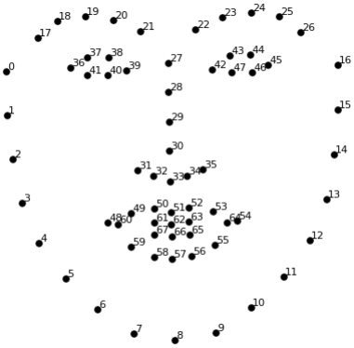
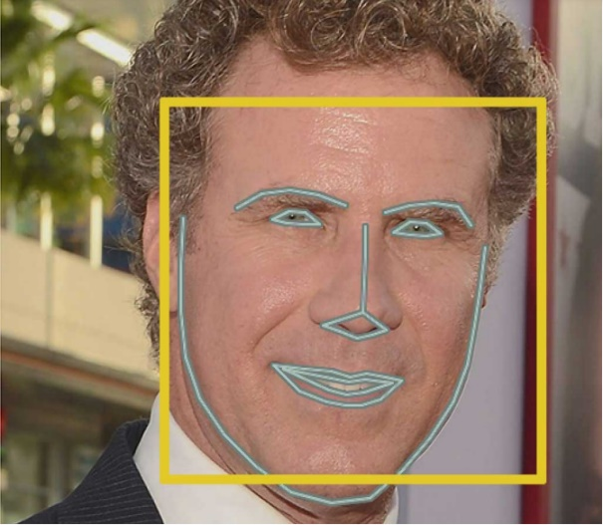
2. Posing and projecting faces.
Problem: images for the same person are different for the computer
Solution: make the eyes and lips always in the sample place in the image.
How? By using the “Face landmark estimation” Algorithm.

Slide 24
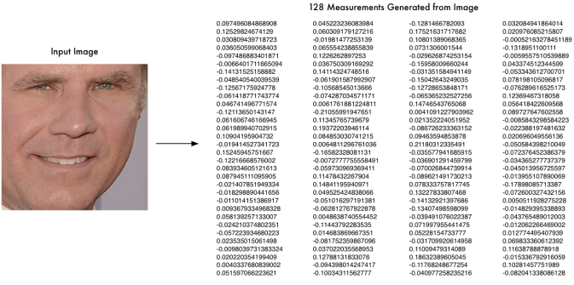
3. Encoding Faces
(Kernel of our problem)
Extract basic measurements for a face.
HOW? Training a CNN to find the best features is the best for this mission.
Result: by getting 128 measurements out of a face.

Slide 25

4. Finding the person’s name from the encoding (the last step).
Comparing the images in the database.
Using SVM Classifier.
The image with the encoding closest to the encoding of ours is the one we are seeking for.

Slide 26
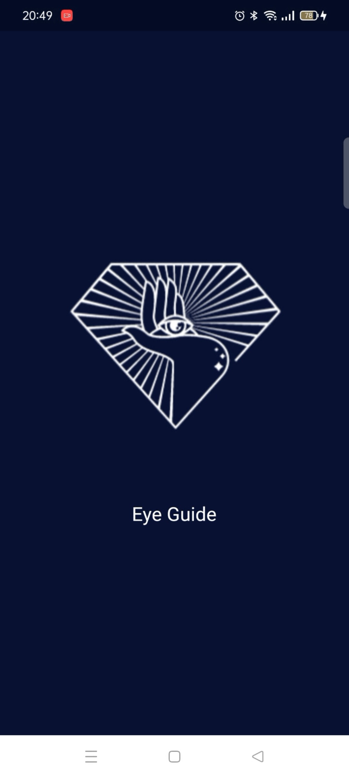

Home Screen.
4. Mobile App Implementation
Done using Flutter framework and flask API.

Slide 27
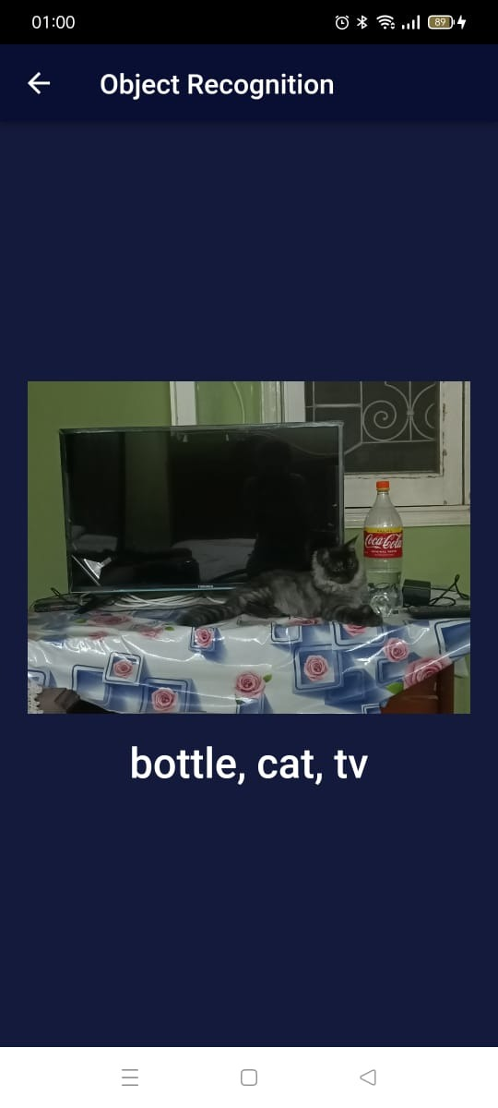
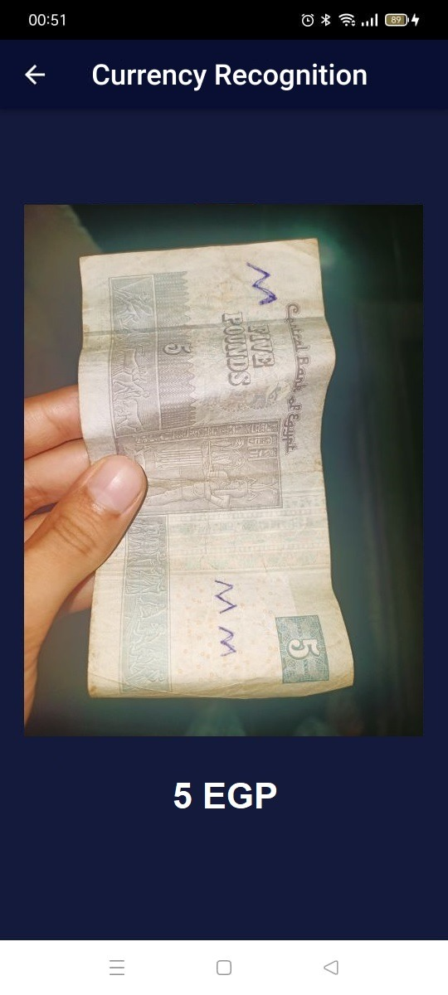
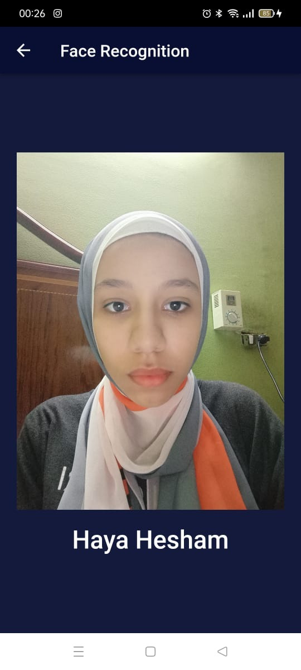
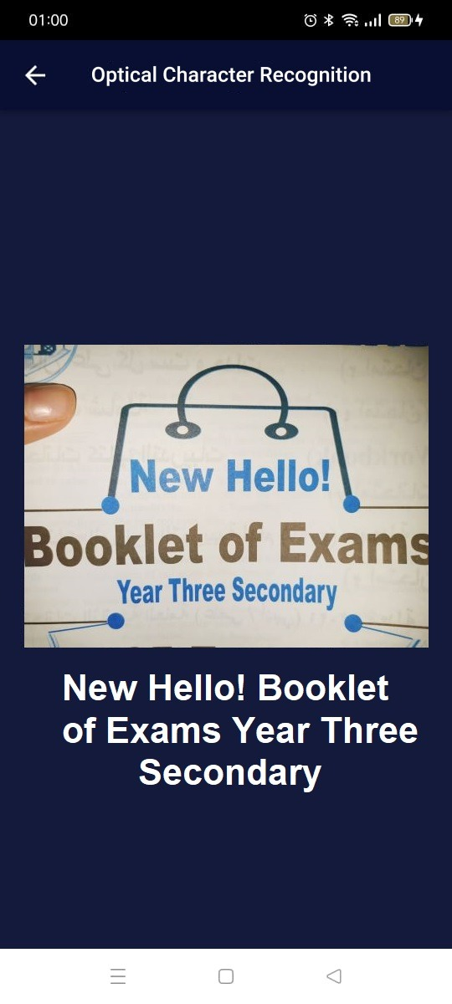
When the user says one
When the user says two
When the user says three
When the user says Four

Slide 28
5. Optical character Recognition (OCR).
OCR is to extract the text from an image it is implemented using the Tesseract OCR engine developed to extract text from images.
How it work?
Converts the document into a black & white version.
Dark means characters and White is the background.
Pattern recognition: is used to define the text in different shapes.
Feature detection: recognizes the characters and numbers.

Slide 29
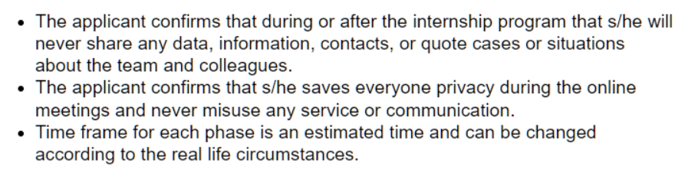
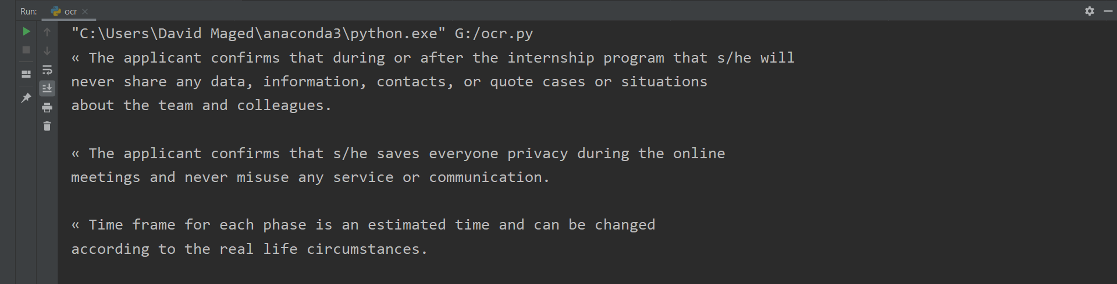
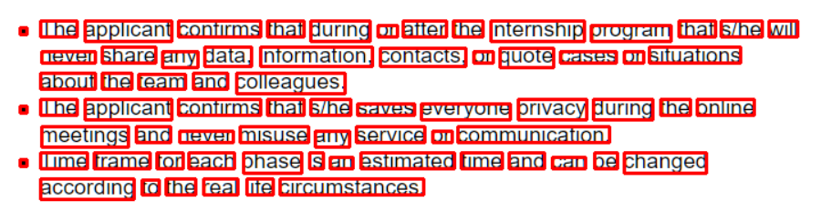
Original image
The Results

Slide 30

6. Speech Recognition
A Google API will be used to:
Convert
text to speech to give instructions to the user.
Convert
speech to text to accept user commands.

Slide 31

Datasets & Description

Slide 32
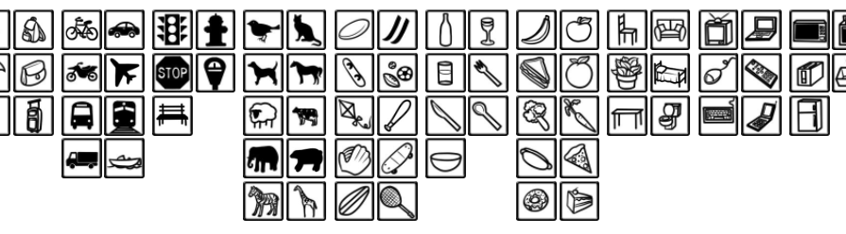
1. COCO Dataset
(Common Objects in Context)
Used for Object Detection
Can classify 91 Objects
Has 330K images
1.5 million object instances

Slide 33
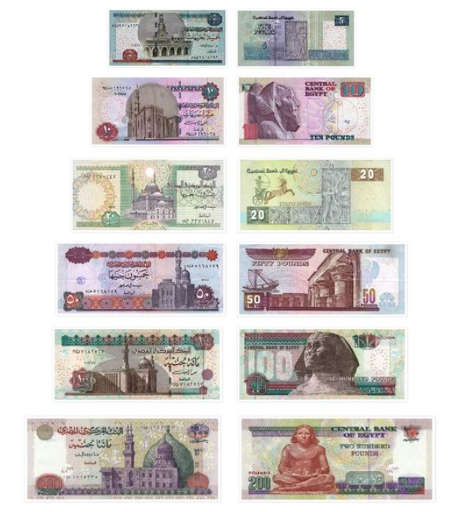
2. Egypt Currency Dataset:
Published on Kaggle.
Has +10K images.
Image sizes are 1080*1080

Slide 34

Demo

Slide 35
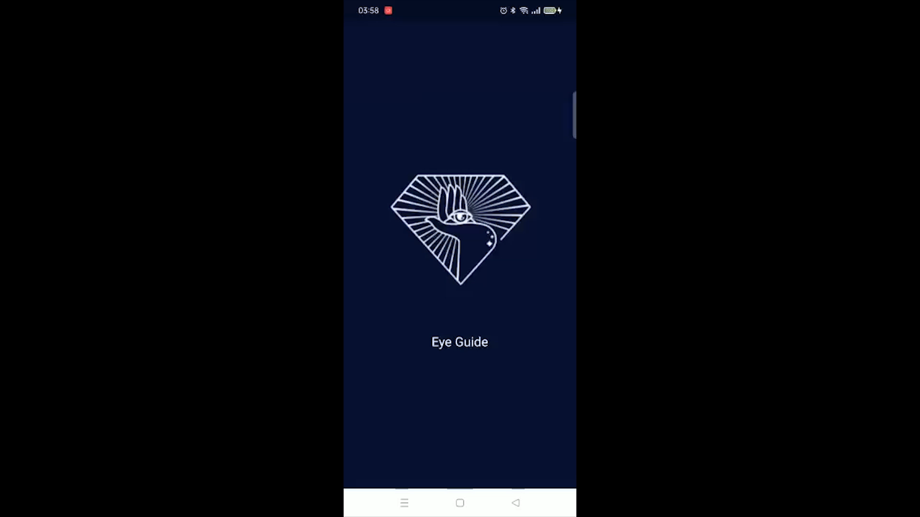

Slide 36
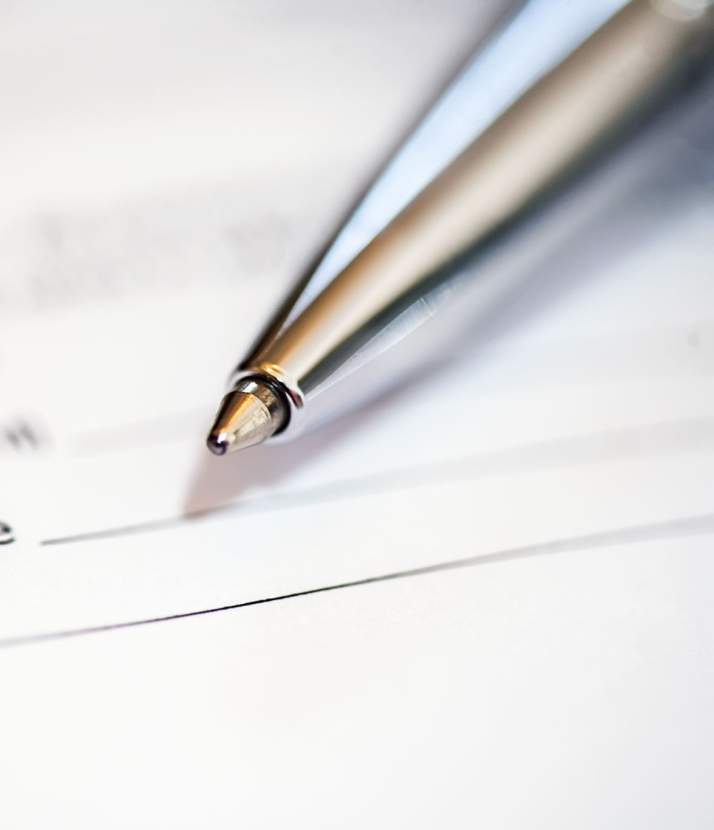
Conclusion & Future work.

Slide 37
Conclusion & Future Work
This is the first version of the EYE Guide app will be available soon on Google Play.
The second version will include two important features:
Guidance Feature.
Image Captioning Feature.

Slide 38
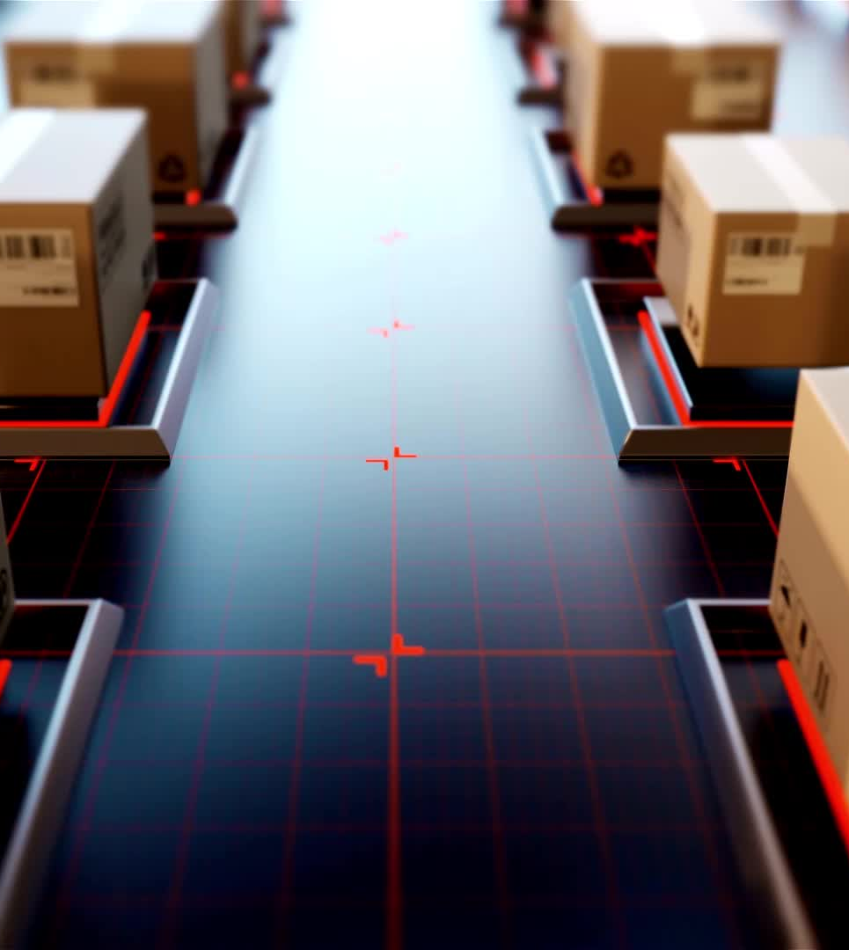
1. Guidance Feature.
To avoid obstacles on the street.
Implementation: by splitting the frame into three parts.
Problem: if the three frames have bounding boxes.
Solution: will hide automatically.

Slide 39
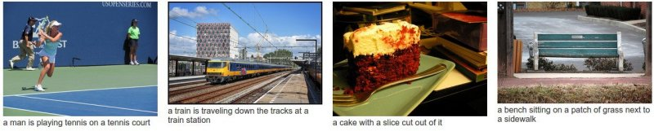
1. Image Captioning
This feature is to help them in describing the scene.
How will it be implemented?
The coco dataset has a caption for each image, a model will be trained on this dataset and the result will be as these photos.

Slide 40

References

Slide 41
References
Shadi, S., Hadi, S., Nazari, M.A. and Hardt, W., 2019. Outdoor navigation for visually impaired based on deep learning. In Proc. CEUR Workshop Proc (Vol. 2514, pp. 97-406).
Sierra, J.S. and Togores, J., 2012. Designing mobile apps for visually impaired and blind users. In The Fifth international conference on advances in computer-human interactions (pp. 47-52).
Chucai Yi, Yingli Tian, Aries Arditi," Portable Camera-Based Assistive Te and Product Label Reading From Hand-Held Objects for Blind Persons". IEEE/ASME TRANSACTIONS ON MECHATRONICS, vol. 19, NO. 3, June 2014
X. Chen and A. L. Yuille, "Detecting and reading text in natural scenes," in Proc. Compute. Vision Pattern Recognise. 2004, vol. 2, pp. II-366-11-373
K. Kim, K. Jung, and J. Kim, "Texture-based approach for text detection in images using support vector machines and continuously adaptive mean shift algorithm," IEEE Trans. Pattern Anal. Mach. Intel., vol. 25, no. 12,pp. 1631-1639,Dec. 2003.

Slide 42
References (cont.)
Abburu, V., Gupta, S., Rimitha, S.R., Mulimani, M. and Koolagudi, S.G., 2017, August. Currency recognition system using image processing. In 2017 Tenth International Conference on Contemporary Computing (IC3) (pp. 1-6). IEEE.
Redmon, J., Divvala, S., Girshick, R. and Farhadi, A., 2016. You only look once: Unified, real-time object detection. In Proceedings of the IEEE conference on computer vision and pattern recognition (pp. 779-788).
Hansen, D.K., Nasrollahi, K., Rasmussen, C.B. and Moeslund, T.B., 2017. Real-time barcode detection and classification using deep learning. In International Joint Conference on Computational Intelligence (pp. 321-327). SCITEPRESS Digital Library.
Shi, B., Bai, X. and Yao, C., 2016. An end-to-end trainable neural network for image-based sequence recognition and its application to scene text recognition. IEEE transactions on pattern analysis and machine intelligence, 39(11), pp.2298-2304.

Slide 43

Questions?

Slide 44

Thank you

